Slide 1
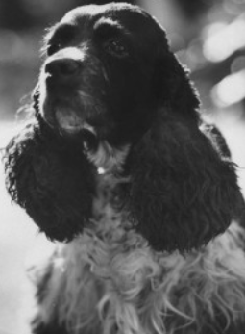
Checkers: most famous dog in US

Slide 2
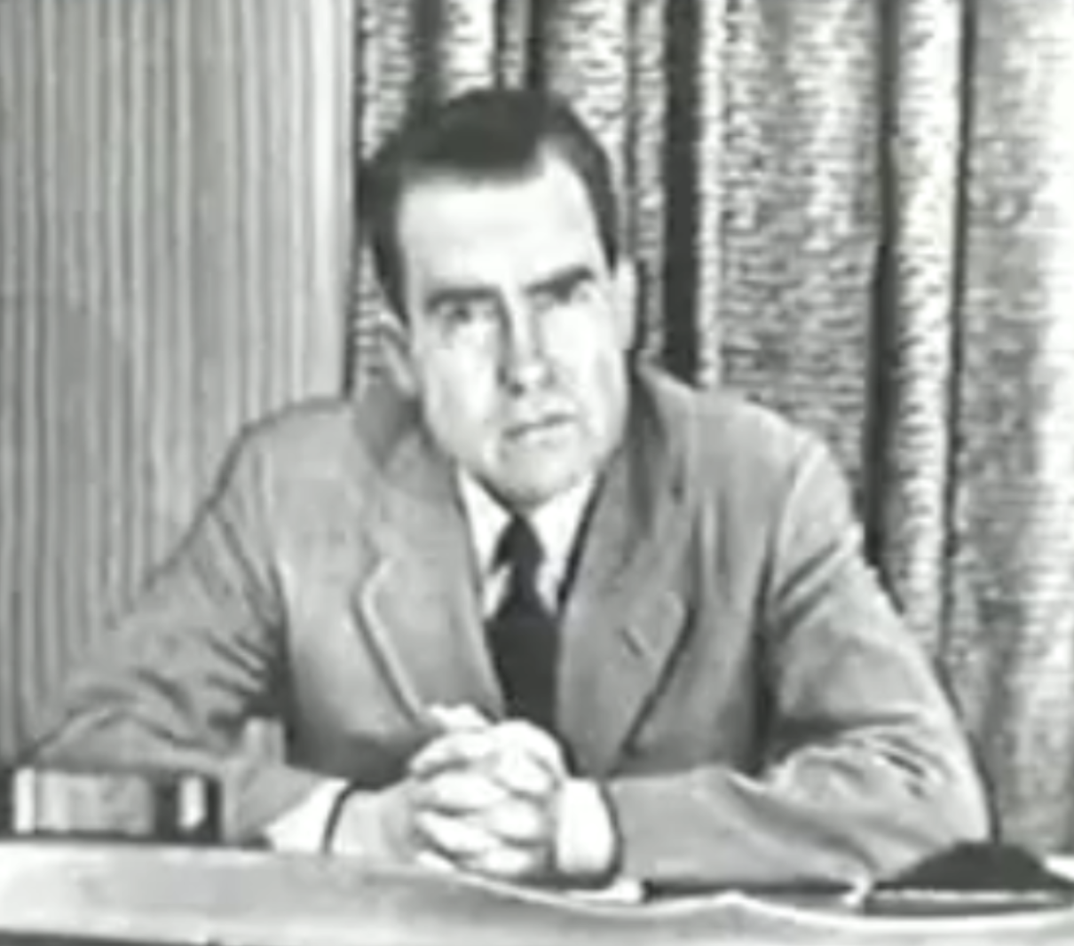
Checkers speech (September 1952)
1952 first TV subject to live TV
Nixon on TV giving “Checkers Speech”
Nixon Senator from California
Famous for Pumpkin Patch, McCarthy
Hearings…modest means, law practice
Campaigns as “man of integrity”
…removes campaign chairman for
Taking funds
‘Secret Fund’ set up to run campaign
…$16,000 ( $200,000 today)
…Release to papers by competitor
Press attacks…one contributor told
“Nixon needs bigger house/maid”
..Nixon…attacks from communists
Eisenhower tells Nixon to go on tv
…appeal to public/ or resign

Slide 3
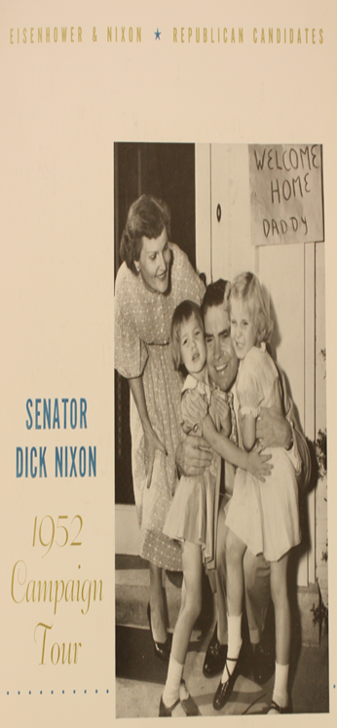
Checkers speech
Nixon publicity (paid by Fund)
Nixon…details expenses….wife does not have Mink Coat..
…good Republican “cloth coat”…then
“we did get something—a gift—after the election. A man down in Texas heard Pat on the radio mention the fact that our two youngsters would like to have a dog. And, believe it or not, the day before we left on this campaign trip we got a message from Union Station in Baltimore saying they had a package for us. You know what it was? It was a little cocker spaniel dog in a crate that he'd sent all the way from Texas. Black and white spotted. And our little girl—Tricia, the 6-year-old—named it Checkers. And you know, the kids, like all kids, love the dog and I just want to say this right now, that regardless of what they say about it, we're gonna keep it!
Response overwhelming positive…Nixon remains VP candidate
…and forever known as “Tricky Dick”

Slide 4
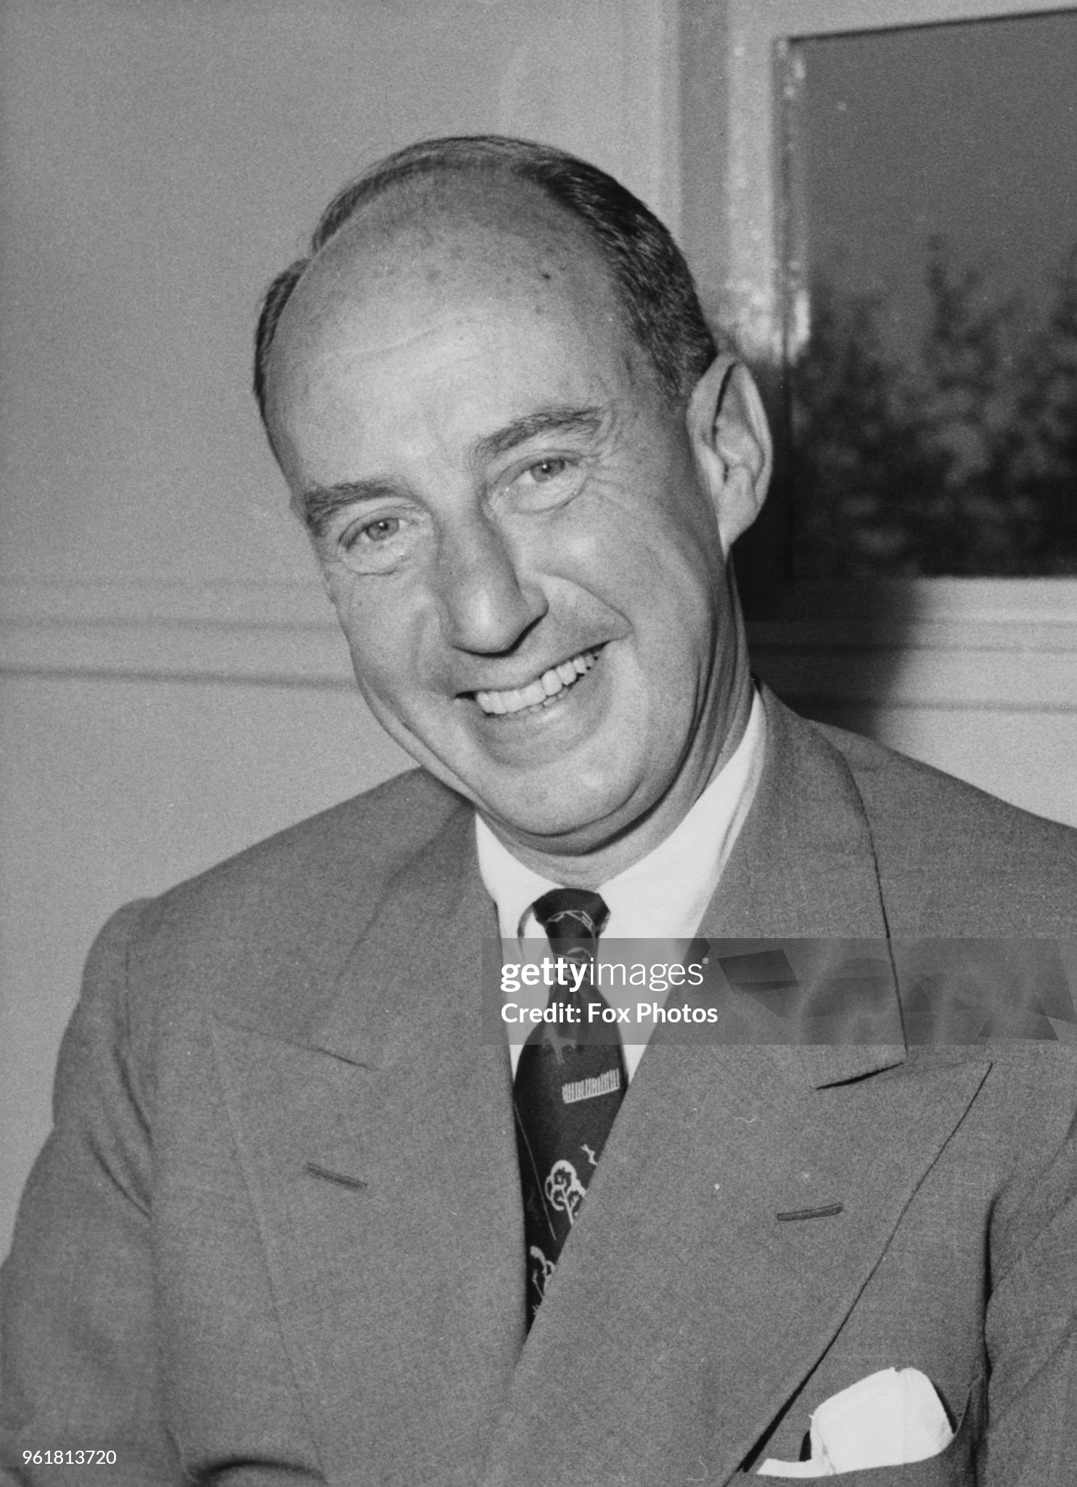
Democrat candidate Adlai Stevenson

Slide 5
Democrat Candidate…no chance vs war hero
About Nixon “was the kind of politician who would cut down a redwood tree, and then mount the stump and make a speech for [tree] conservation".
“Uncomfortable with the carnival side of elections, Stevenson tried to be a man for the people, not of them; a man of reason talking sense, not manipulation or sentiment
“egghead "speech “"eggheads of the world unite, you have nothing to lose but your yolks!“
Attacks McCarthy, defends Alger Hiss …accused of being “soft on Communism” and gays
A gentleman: Declines release letter from Eisenhower to Marshall in 1944 wanting to divorce his wife and marry Kate Summerville….(Marshall rejected)
US politics….no room for gentlemen

Slide 6
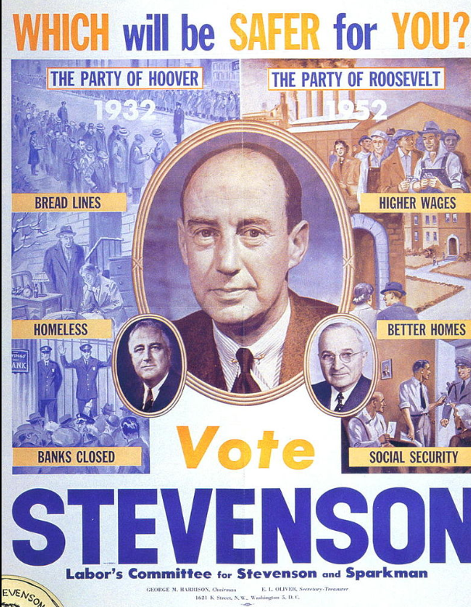
Adlai Stevenson poster…New Deal forever

Slide 7
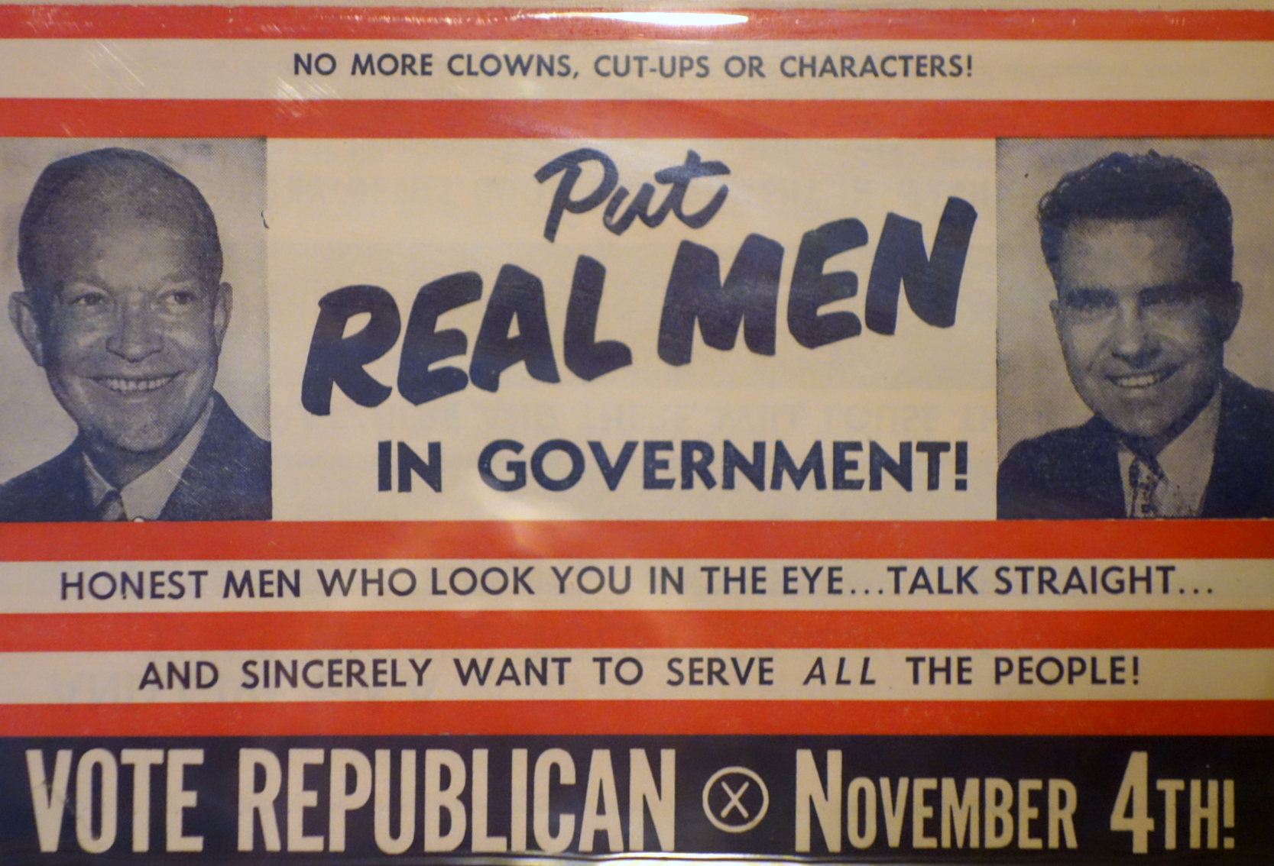

Slide 8
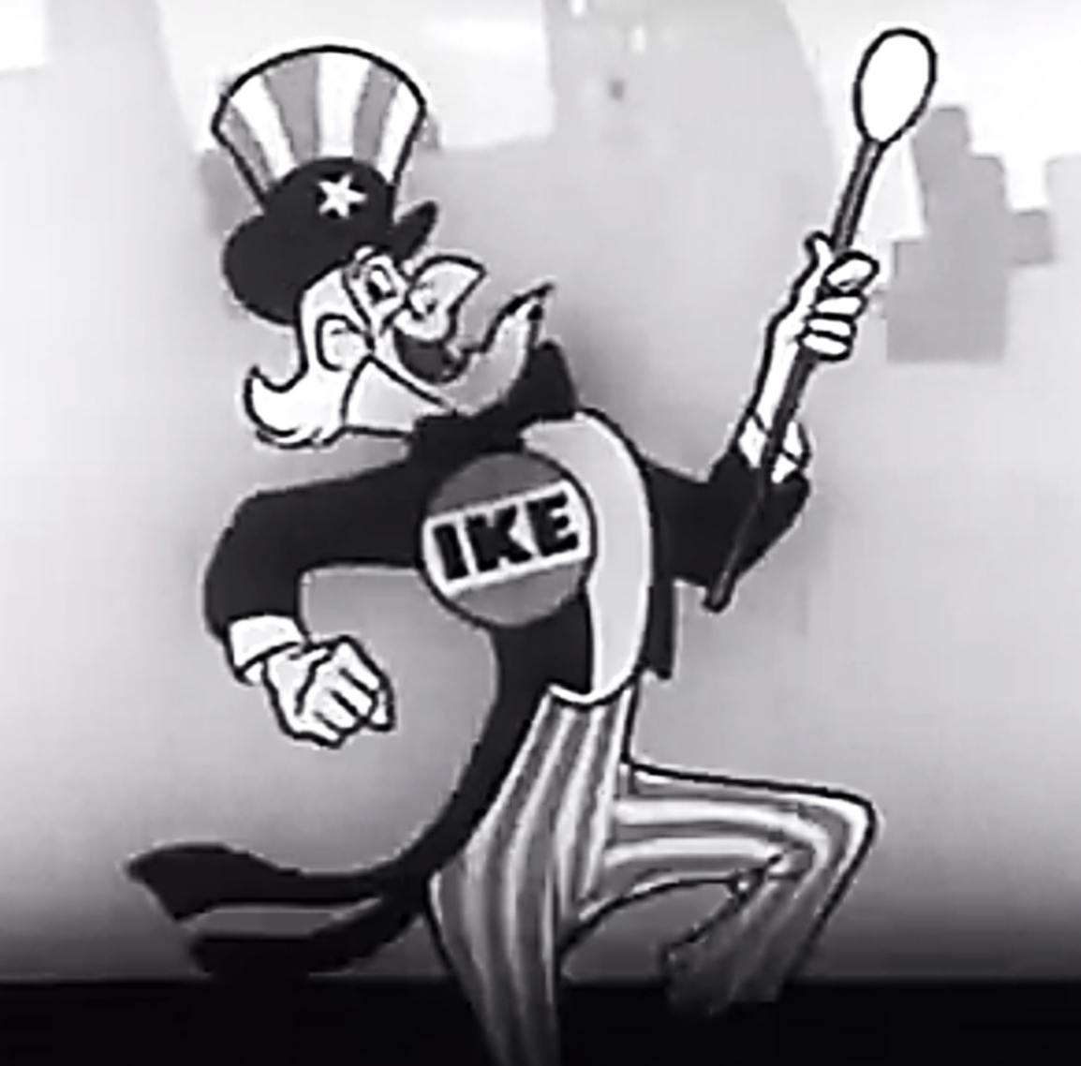

Slide 9
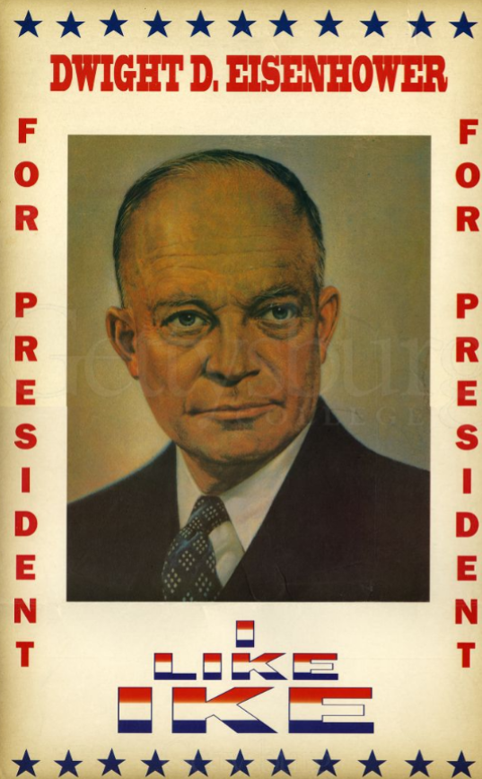

Slide 10
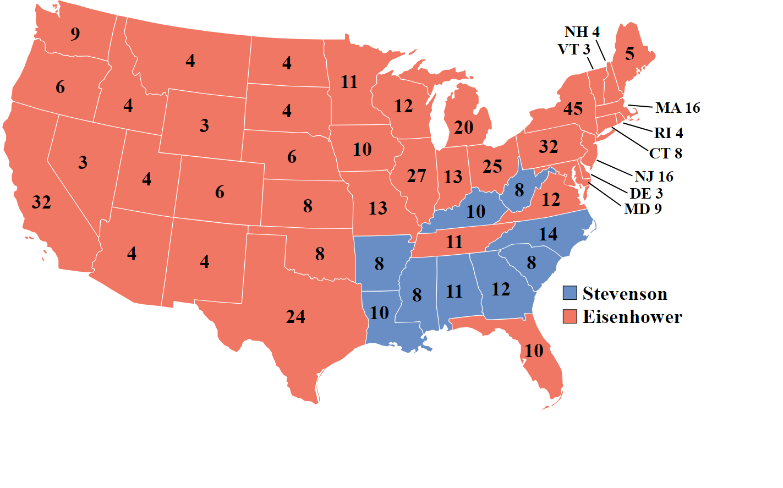
Republican Landslide
Eisenhower 55% vote, vs 45% 442 electoral votes vs 89
Votes for Ike…not Republicans
Republicans 1 seat majority Senate
20 majority House
Consensus for maintaining
New Deal, high income taxes,
Social Security
Ends 20 year Democrat Control
Same candidate, same result
1956…Ike at 57% vote

Slide 11
Eisenhower Presidency (1952-1960)
Main interest and focus Foreign Affairs (more in Talk 35)
Committed to burying isolationist thought
Ending Korean War
Use superior missile technology to offset USSR manpower
Missile attack preparedness ….”duck and cover”
“Progressive Republican”
Maintain New Deal basics while support business
Reduce government oversite/ control expenditure
Presidential Style
Commander in Chief…President to execute (not create) law, adhere to courts
Social Change…job of Courts and Congress
His role: live by example, news conferences, inspire trust
Major initiative: US highway network

Slide 12
Eisenhower quotes
This world of ours... must avoid becoming a community of dreadful fear and hate, and be, instead, a proud confederation of mutual trust and respect.
If a political party does not have its foundation in the determination to advance a cause
that is right and that is moral, then it is not a political party; it is merely a conspiracy to
seize power.
Leadership consists of nothing but taking responsibility for everything that goes wrong
and giving your subordinates credit for everything that goes well.
People talk about the middle of the road as though it were unacceptable. Actually,
all human problems, excepting morals, come into the grey areas. Things are not all
black and white. . There have to be compromises. The middle of the road is all of the
usable surface. The extremes, right and left, are in the gutters.

Slide 13
US Highways Act 1956
No national highway system
1921 Highways Act: State responsibility
Mostly two way highway “toll roads”
Eisenhower and highway system
Cross road trip “motor convoy” 1919/ German autobahn
Highway system for defence/ mass relocation
Public works project needed as Korean War ends
Initial cost estimate $25Bn over 13 years,…actual £114Bn over 35 years
Paid by fuel taxes (19c a gallon since 1992)
42,000 miles…in process roads “grandfathered toll roads”

Slide 14
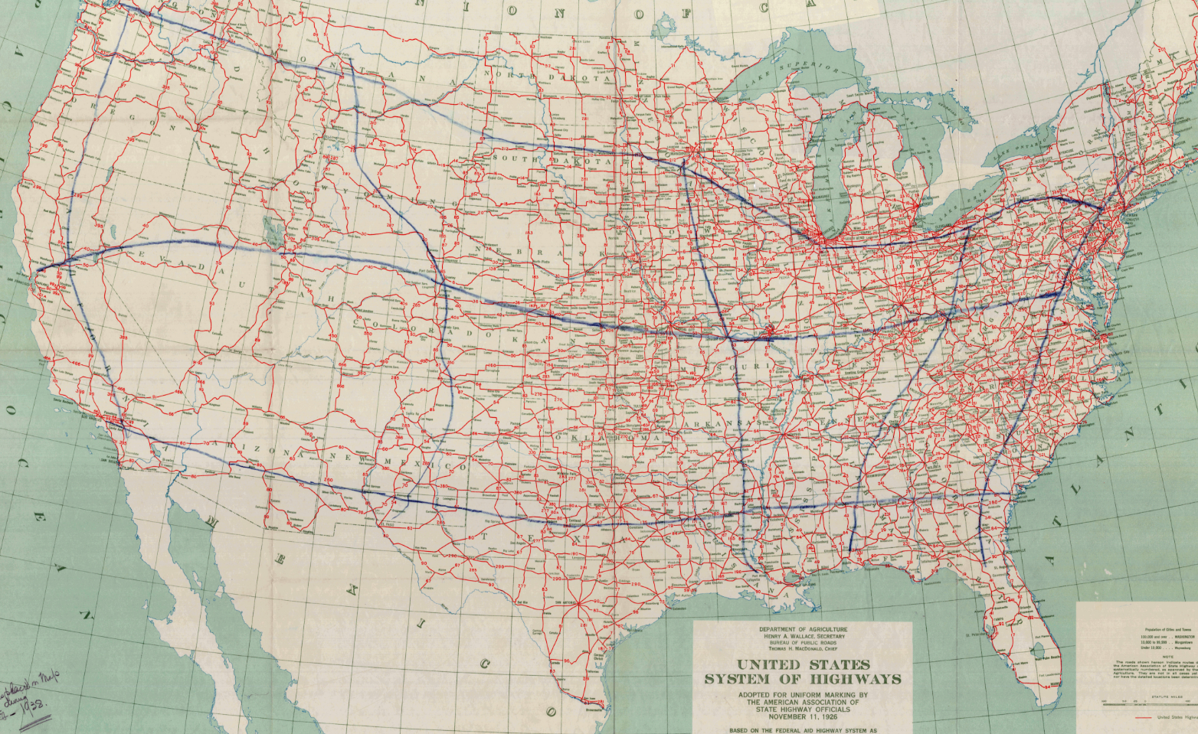
US Highway System 1935

Slide 15
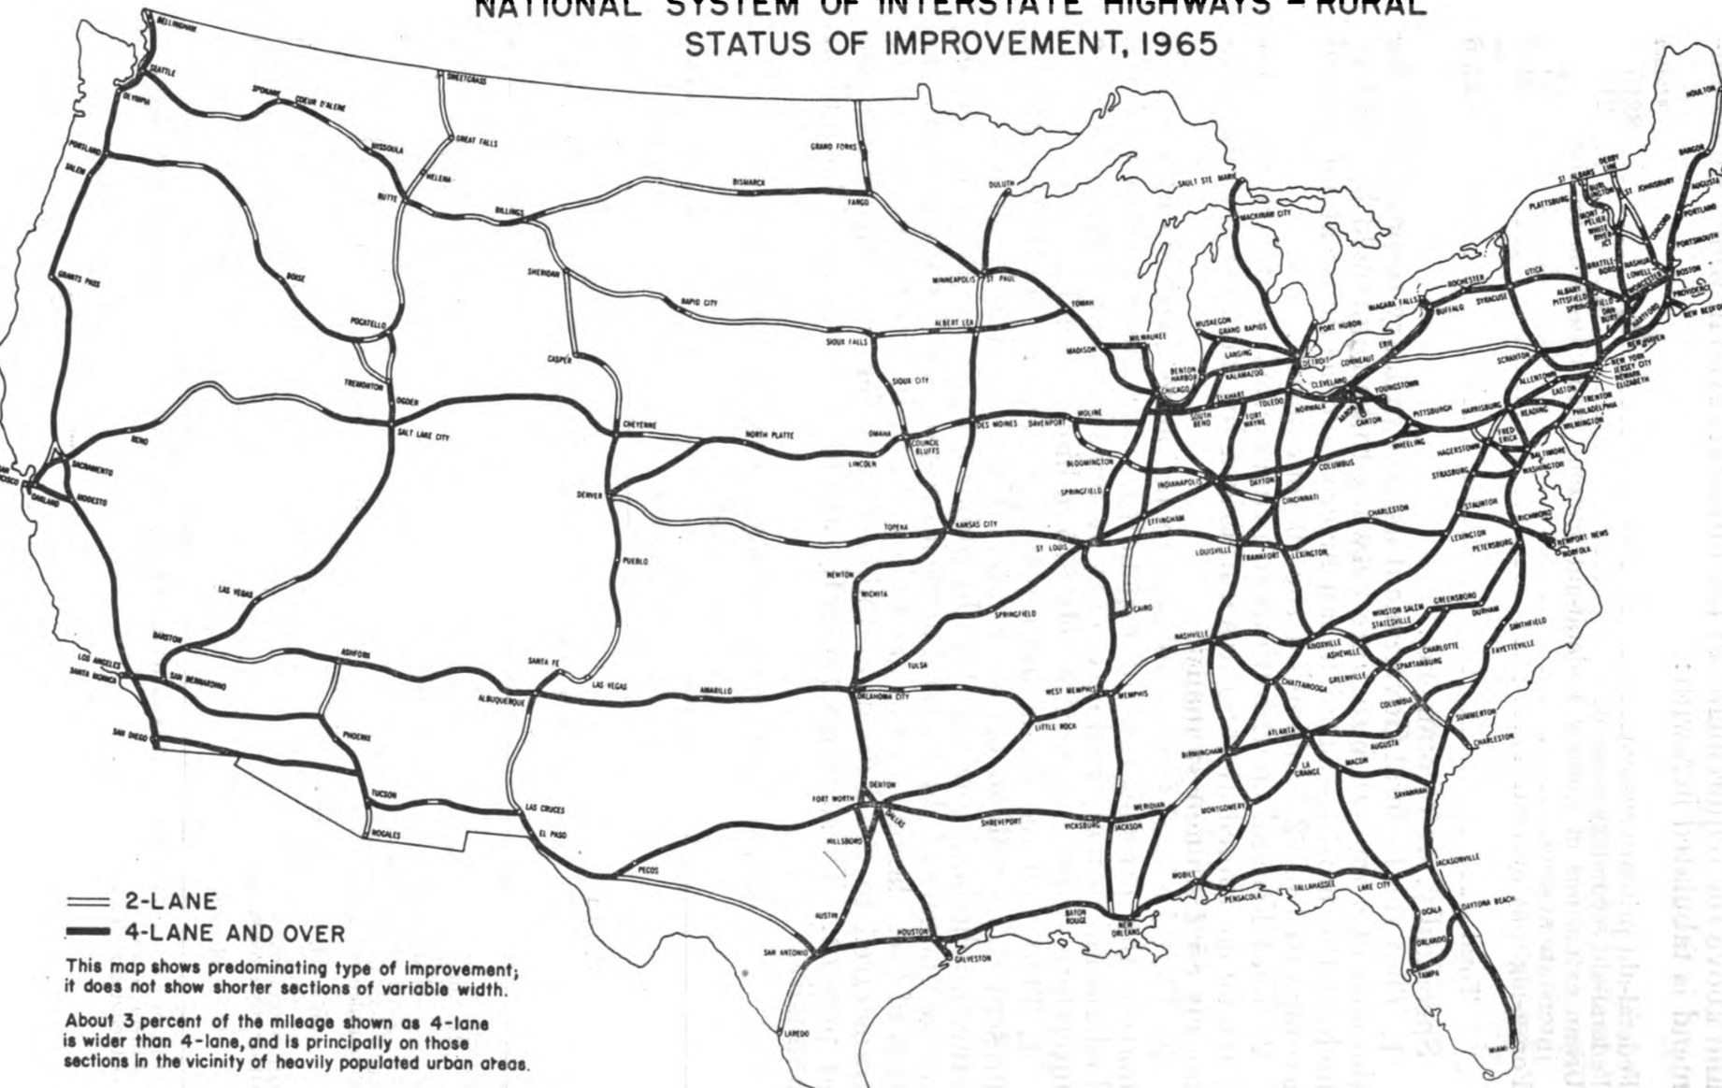
US interstate freeway system 1965

Slide 16
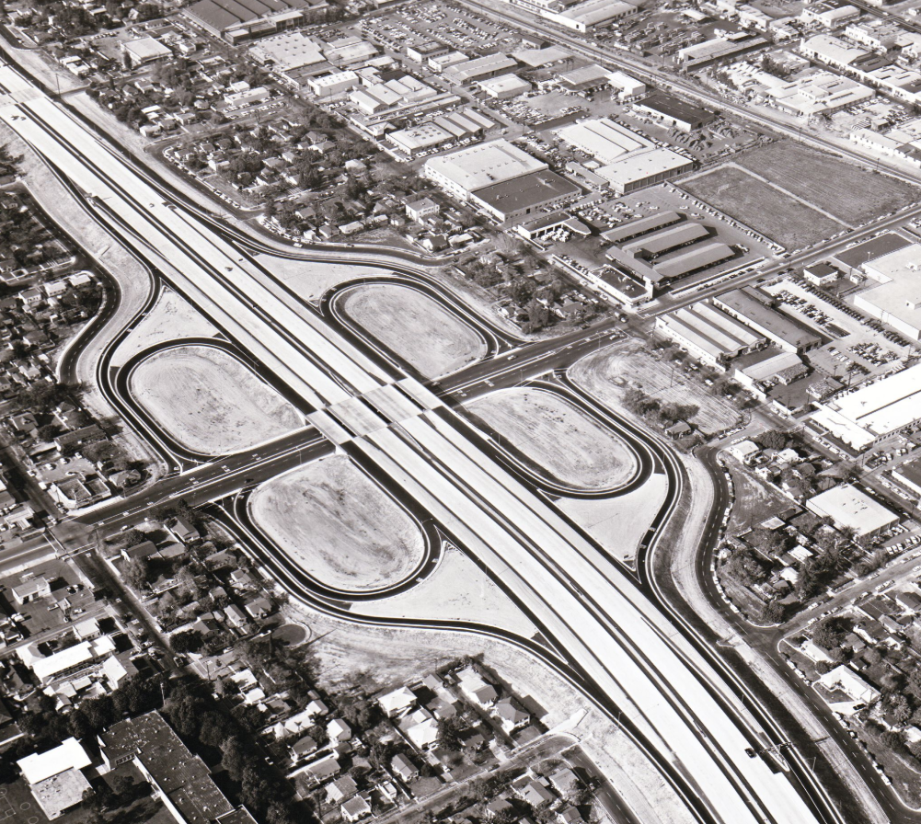
Interstate 5, Glendale California 1957

Slide 17
Impact of Highway System
Decline of Railroad System
Rise of Trucking industry…and Teamster Union
Fossil fuel dependency….Middle East interest
Urban restructuring
Growth of suburbs
Destruction inner city neighbourhoods
Urban segregation by race/ class
Outlet shopping…mall culture
US becomes an “automobile society”

Slide 18
The affluent Society

Slide 19
Population 1950- 1960
Population increases 20% from 151m to 179m
No significant change to mix of race (Whites 88% 1950, 84% 1960),
Population moving West California 48% increase (from 11m to 15m), Florida 78%
”middle class” becomes dominant social group (from 30% 1930 to 60% 1960)
High birth rate (50% from 2.9 births per 1,000 to 3.8 per 1000 women
Low level of immigration (1m less per year) due to quota system), foreign born population declines from 10% to 5% of population
Accelerated migration blacks from South to North
Black population in South declines form 29% to 25%
New York increases from 10% to 14%, Chicago from 14% to 23%

Slide 20
Economy 1950’s
 | 1930 | 1940 | 1950 | 1960
GDP | $91Bn | $101Bn | $293Bn | $542 Bn
US Debt | $16Bn | $43Bn | £257Bn | $286Bn
Debt % | 17% | 42% | 87% | 53%
Economy did not recover from Depression till 1939
Inequality reduced by high taxes (top rate 91%)
1% owned 45% wealth 1930, 25% 1960 (40% now)
Growth 190% 1940-1950 then 87% during 1950s
Debt remained high (Cold War/ Infrastructure/Marshall Plan) at $280Bm
………but no problem due to growth (from 150% GDP to 40%)

Slide 21
1950’s….The Golden Age (white males)
“Real purchasing power increased by 30%
Car/steel wages increase 65% £20 hour (2024), teacher 40% to £40K year
Car ownership rises from 40% to 65%, home ownership 40% (1940) to 60%
New technologies at lower prices (9% owned tv 1950,90% 1960..average cost decreased from $300 to £200 (£2,500 to £1,900 in 2025£)
Government expenditure Rising incomes, steady employment
GI Bill public Education/ funded School Systems
New Deal programmes continue (FHA, TVA, Social Security expanded)
the “automotive society” is born…bigger, safer, more elaborate
….but no more economical (10 miles per gal)

Slide 22
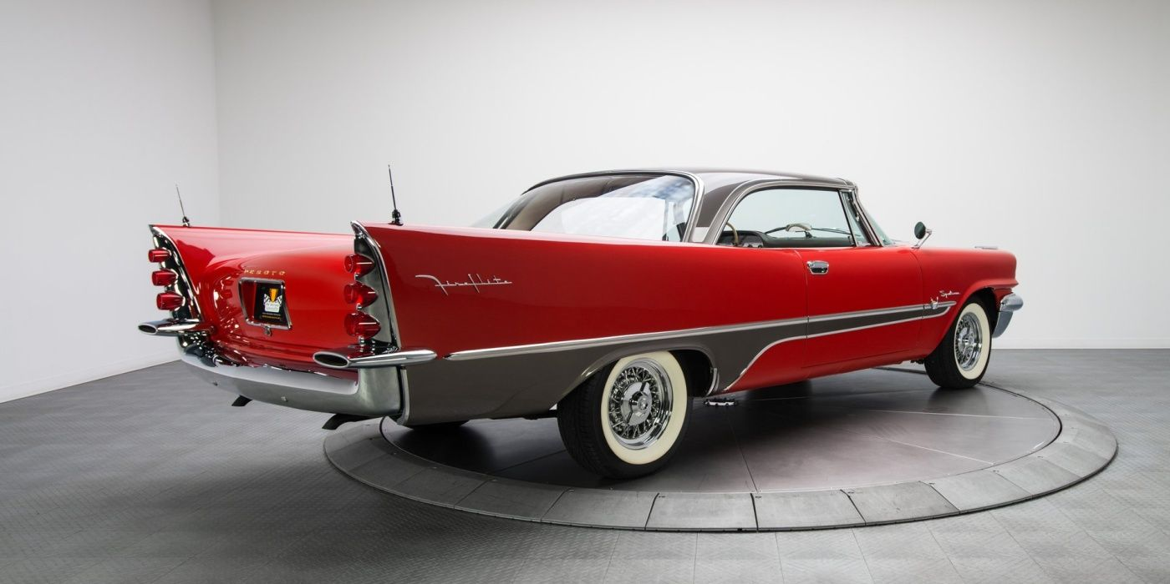
1957 De Soto Firelite

Slide 23
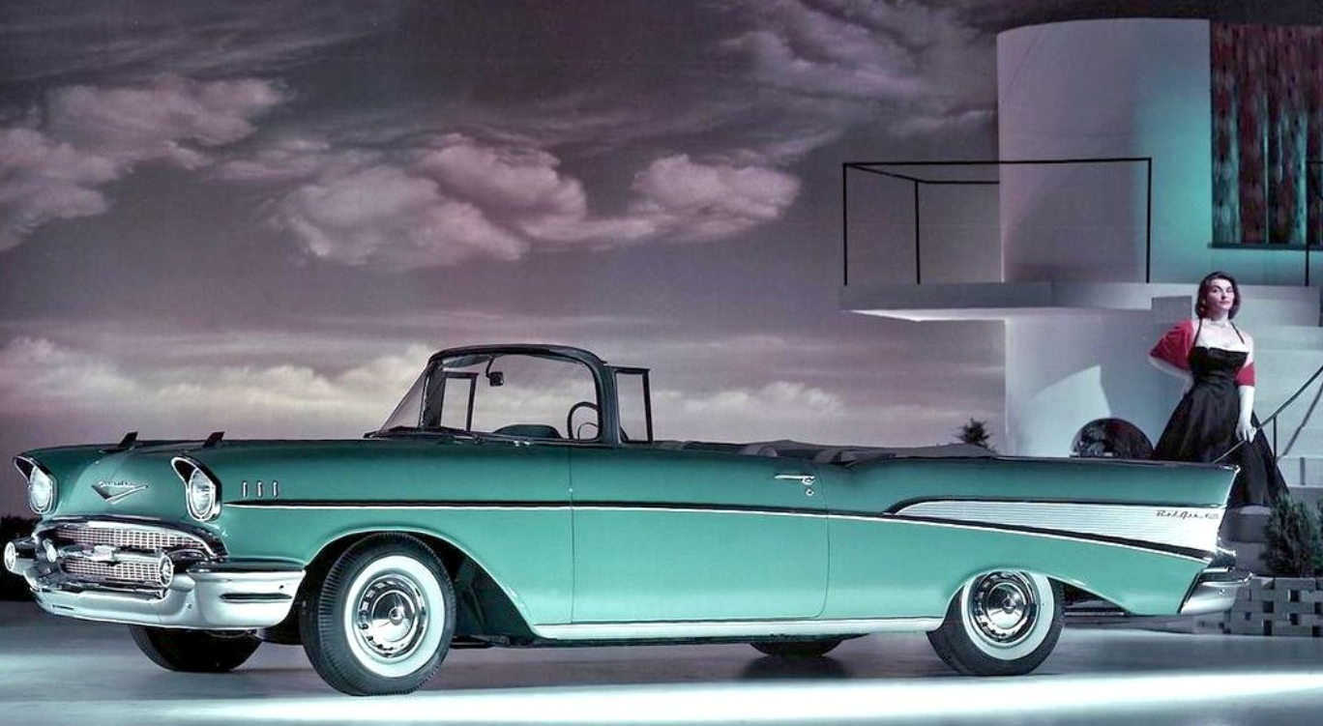
1957 Chevrolet Bel Air Convertible

Slide 24
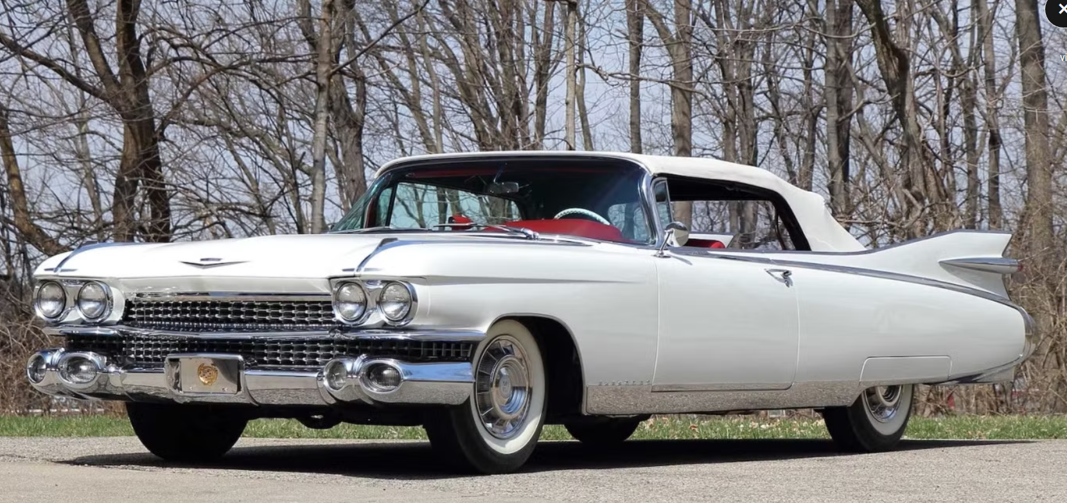
1959 Cadillac Biarritz

Slide 25
Patti Page (1952)
How much is that doggie in the window? The one with the waggly tail How much is that doggie in the window? I do hope that doggie's for sale
I must take a trip to California And leave my poor sweetheart alone If he has a dog, he won't be lonesome And the doggie will have a good home
How much is that doggie in the window? The one with the waggly tail How much is that doggie in the window? I do hope that doggie's for sale

